Slide 1
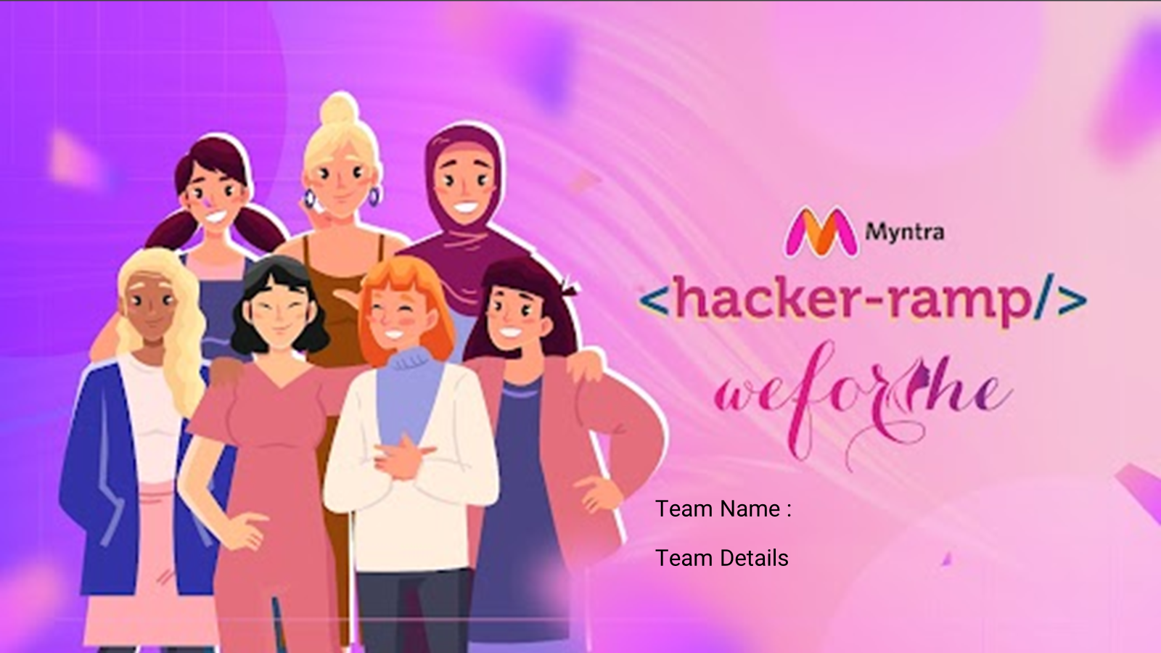
MynChamps
Ananya Bansal (Team Leader)
Saneha Garg (Team Member 1)
Mannat Pruthi (Team Member 2)

Slide 2
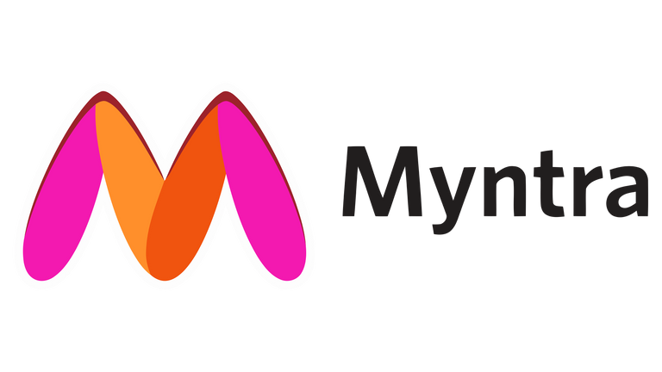
Problem Statement
GlowUp!
#GOAT
TREND-IDENTIFICATION & TREND-CENTRIC RECOMMENDATIONS:
Utilize data analytics and market research to identify emerging fashion trends. Employ AI-driven recommendation systems that analyze current fashion trends, customer preferences, and purchase history to deliver tailored product suggestions, enhancing customer engagement and conversion rates in the fast fashion segment.
SOCIAL SHOPPING INTEGRATION:
Integrate social media functionalities and user-generated content, such as influencer collaborations, customer reviews, and shoppable posts, to create an interactive and immersive shopping experience that resonates with fast fashion enthusiasts, positioning Myntra as the go-to destination, driving customer growth and conversion.

Slide 3
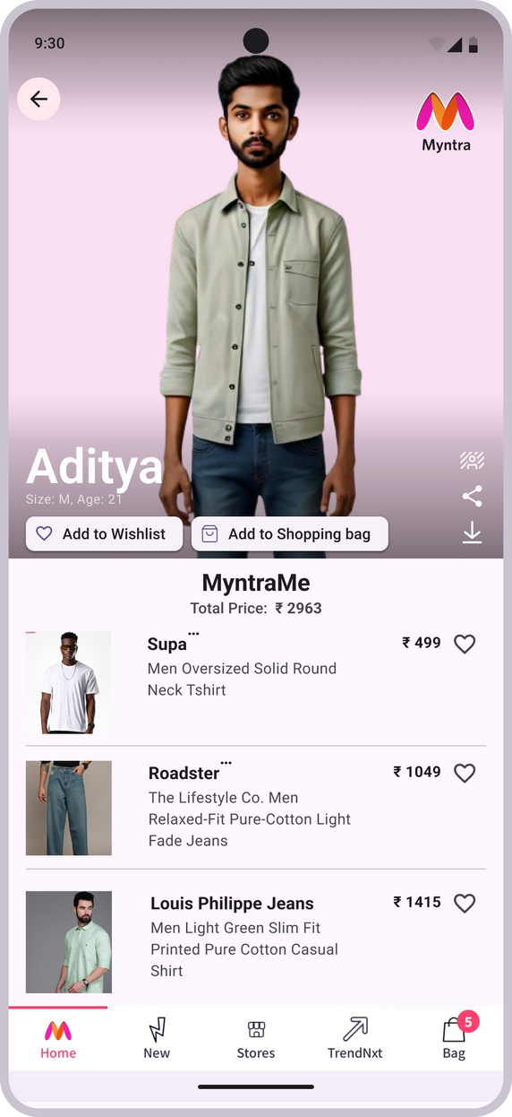



Solution 1
Create your very own MyntraMe!
Idea:
#Slay
MYNTRA'S VIRTUAL FASHION AVATAR FEATURE: MYNTRAME
Step into the future of fashion with Myntra's Virtual Fashion Avatar. Craft your virtual twin and explore a vast selection of clothes, accessories, and shoes in stunning detail. Powered by AI and AR, this feature delivers life-like simulations of fit and style, revolutionising how you shop online. Say goodbye to guesswork, embrace personalised perfection, and elevate your shopping experience.
Select your Details.
Change your background: Bougee, Basic or Lit, as you like!
Share your fit check with your FAM!
Focus:
Download your DRIP
BOOST ENGAGEMENT WITH MYNTRA'S VIRTUAL FASHION AVATAR, CONNECTING AND CAPTIVATING YOUNGER AUDIENCES WITH PERSONALIZED, AI-POWERED FASHION EXPERIENCES.
Get this whole look A$AP!
Tech-Stack:
Frontend: React Native, Three.js
Backend: Node.js, Express.js
AI/ML: TensorFlow.js, OpenCV
AR: ARCore (Android), ARKit (iOS)
3D Modeling: Blender, Babylon.js
Database: MongoDB, PostgreSQL
Platform:
Send
MYNTRA'S MOBILE APPLICATION
FITCHECK!

Slide 4

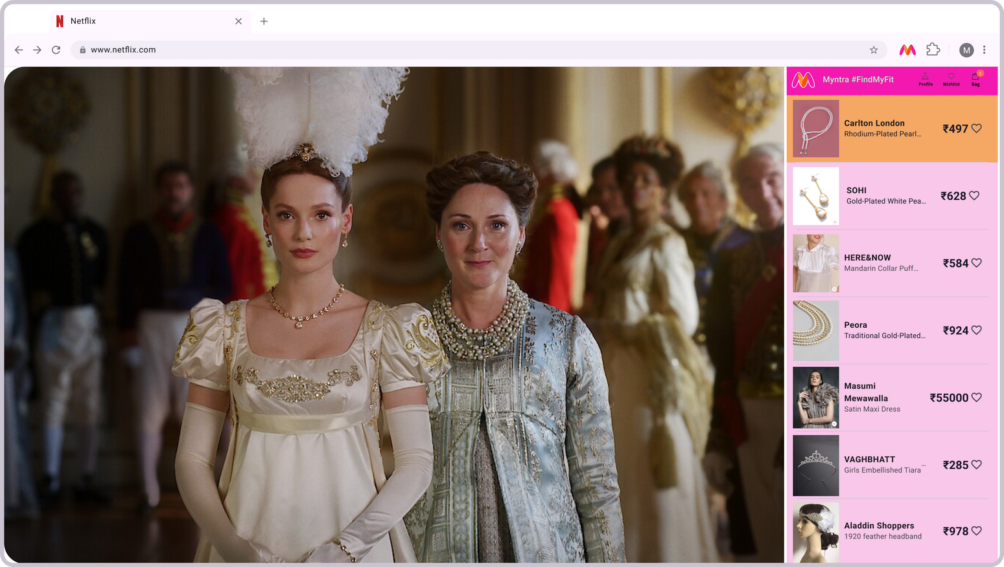
Solution 2
Add Myntra’s #FindMyFit chrome extension and use it anytime, anywhere!
Idea:
BROWSER EXTENSION FOR SEAMLESS SHOPPING INTEGRATION: #FINDMYFIT
To extend the shopping experience beyond the Myntra platform, a browser extension can be added, enabling users to discover similar products while browsing the web. When watching a series or browsing content online, the extension identifies clothing and accessories and provides links to similar products available on Myntra. This seamless integration allows users to instantly shop for items they find appealing, capitalizing on spontaneous shopping impulses and driving additional traffic to Myntra's site.
Tech-Stack:
Frontend: Javascript, HTML/CSS
Frameworks: Browser Extension APIs,React,Axios
Backend: Node.js, Express.js
Database: MongoDB
API Integration: Myntra API, Browser API
#no
FOMO
Never miss out on the latest trendsss!
Focus:
Platform:
SHOP WHAT YOU SEE: INSTANTLY DISCOVER AND BUY SIMILAR PRODUCTS WITH MYNTRA'S NEW BROWSER EXTENSION
MYNTRA'S WEBSITE

Slide 5
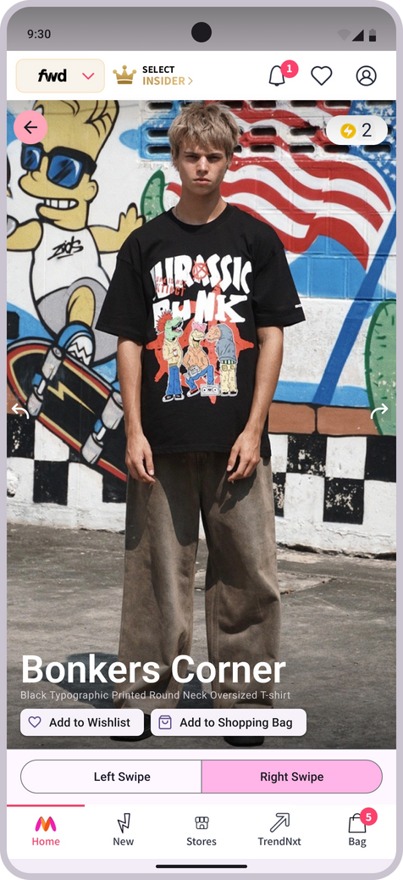
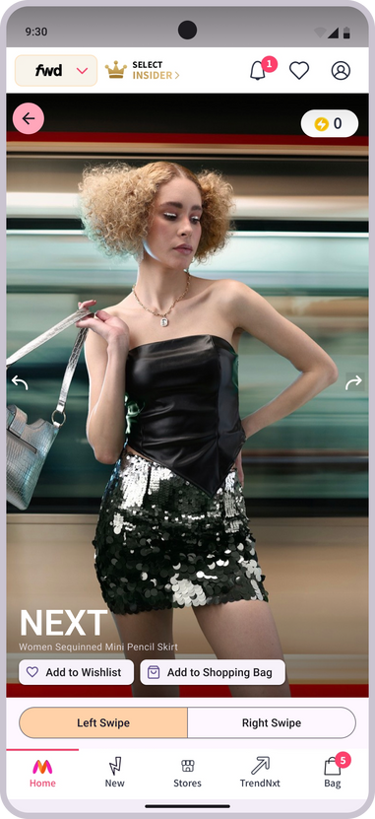
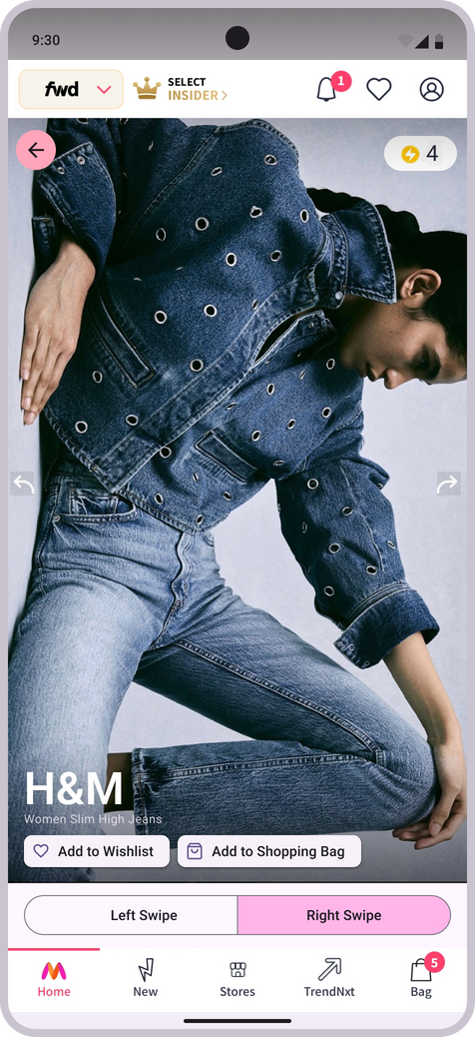
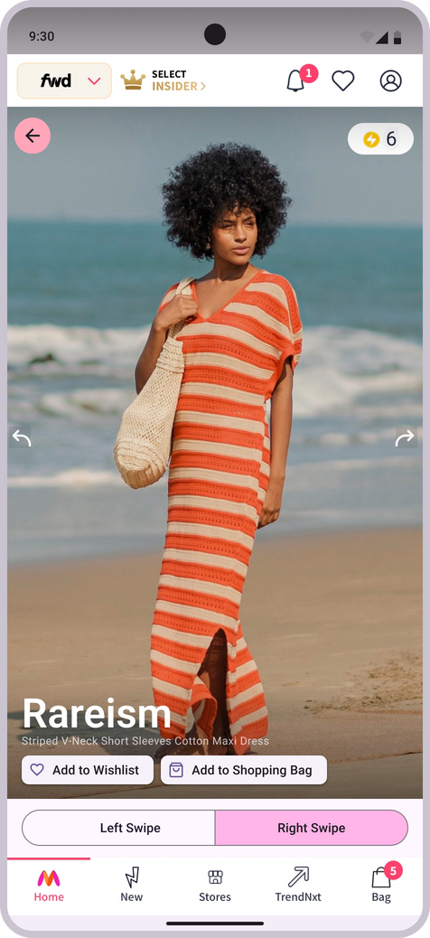
Solution 3
Idea:
Earn Myntra SuperCoins for every swipe!
PERSONALIZED FEED WITH SWIPE-BASED INTERACTION:
Myntra can enhance user engagement by implementing a swipe-based recommendation system where users can swipe left or right to indicate their preferences. Each user is allowed up to five right swipes per day, making their choices more deliberate. With every swipe, users earn points that accumulate towards discounts on future orders. This gamified approach not only makes shopping more interactive and enjoyable but also incentivizes regular use, leading to increased customer loyalty and higher conversion rates.
Focus:
FASHION FORWARD ENGAGEMENT: REVOLUTIONIZING USER INTERACTION ON MYNTRA WITH SWIPE-BASED TREND IDENTIFICATION
Left swipe = CANCELLED!
Tech-Stack:
Platform:
#SIMPing
Frontend: Javascript, React
Backend: Node.js, Express.js
Database: MongoDB
API Integration: Myntra API, Browser API
Authentication: JWT, OAuth
Machine Learning: TensorFlow/PyTorch, Collaborative Filtering, Neural Collaborative Filtering (NCF), Recurrent Neural Networks (RNNs)
MYNTRA'S MOBILE
APPLICATION
Right swipe for the looks that SLAPS!
Swipe and Earn!

Slide 6
Benefits
#No
CAP
Enhanced Shopping Convenience: Seamlessly integrate the virtual fashion avatar with a browser extension, allowing users to discover and purchase similar products from Myntra while browsing other websites or streaming content online. This convenience minimizes the effort of switching between platforms and captures spontaneous shopping impulses, making the shopping experience more fluid and enjoyable.
Improved User Engagement: Implementing a personalized feed with swipe-based interaction enhances user engagement by tailoring product recommendations based on user preferences. The swipe feature allows users to indicate their likes and dislikes effortlessly, refining the recommendations to match their individual tastes more accurately over time.
Gamified Shopping Experience: The swipe-based interaction not only makes shopping more interactive but also gamifies the experience by rewarding users with points for each swipe. These points accumulate and can be redeemed for discounts on future purchases, incentivizing users to interact regularly with the platform and fostering customer loyalty.
Increased Conversion Rates: By integrating these features, Myntra enhances user satisfaction and loyalty, leading to higher conversion rates. Users are more likely to make purchases when they can effortlessly discover products of interest, receive tailored recommendations, and benefit from rewards for their engagement.
Seamless Cross-Platform Integration: Bridge the gap between browsing and shopping with the browser extension, ensuring a cohesive experience that keeps users engaged across platforms.
Increased Brand Exposure: Extend Myntra's reach by integrating with users' everyday online activities, placing the brand in front of potential customers during their browsing and streaming sessions.
Data-Driven Personalization: Utilize swipe-based interactions to gather valuable user data, enabling more accurate and personalized recommendations that resonate with individual preferences and behaviors.
Community Building: Foster a community of engaged shoppers through interactive features like gamification and social sharing, encouraging user interaction and word-of-mouth referrals.
Iterative Improvement: Continuously refine the user experience based on collected data and user feedback, ensuring the platform evolves to meet changing consumer expectations and preferences.

